Slide 1
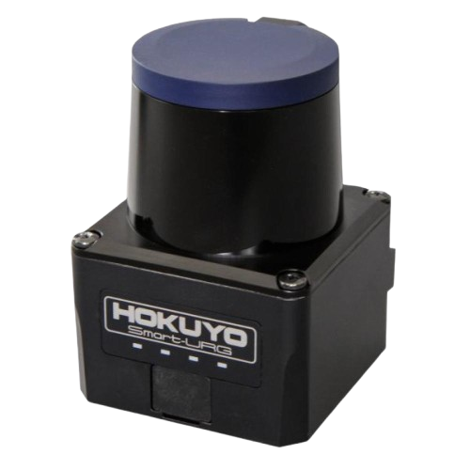
Hokuyo UST20LX
Description
Hokuyo UST20LX is a 2D LiDAR.
It is compact, lightweight, and designed for indoor environments, like robotics and automation.
The sensor excels in SLAM, obstacle detection, and navigation tasks, providing high accuracy and reliability.
Specifications
Operating Voltage - 12V to 24V
Detection Range - 20m
Scanning Angle - 270 deg
Scan Speed - 25ms (Motor Speed 2400 RPM)
Applications
Autonomous Robots
Unmanned Aerial Vehicle
People Counting
Analysis of Human Movement Patterns
Official Website : https://www.hokuyo-aut.jp/search/single.php?serial=167

